Slide 1
C# Programming
MAD401

Slide 2
Introduction to C#
Lecture 5

Slide 3
Objectives
Value Types
Structs
Boxing
Enums
Well Formed Types
Operator Overloading
Namespaces
Resource Cleanup
Generics
Benefits
Declaring
Using

Slide 4
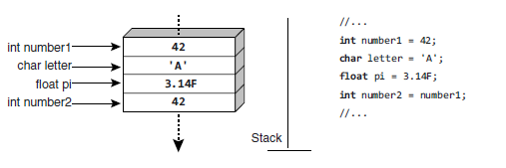
Value Types
Variables of value types directly contain their values
ie. int, char, float
The variable name is associated directly with the storage location in memory where the value is stored
When a second variable is assigned the value of an original, a copy of the original is made to the storage location associated with the second
Two variables never refer to the same storage location

Slide 5
The Stack
Passing an instance of a value type to a method will also create a copy from the storage location associated with the argument to the storage location associated with the parameter
Variables and temporary values of value types can often be stored on the temporary storage pool called the stack
The stack is less costly to clean up than the garbage collected heap
However, copying values impose a performance cost of its own

Slide 6
Reference Types
The value of a reference type variable is a reference to an instance of an object
Variables of reference type store the reference (memory address) where the data for the object instance is located (the Heap), instead of storing the data directly, as a variable of value type does
To access the data, the runtime will read the reference out of the variable and then dereference it to reach the location in memory that actually contains the data for the instance

Slide 7
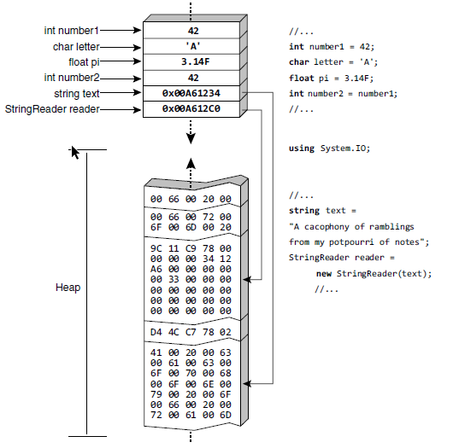
Reference Types

Slide 8
Reference Types
A reference type variable has two storage locations associated with it: the storage location directly associated with the variable, and the storage location referred to by the reference that is the value stored in the variable.
Imagine a piece of paper that has a house address written on it—for example, “123 Sesame Street, New York City.” The piece of paper is a variable; the address is a reference to a building.
If you make a copy of that reference on another piece of paper, the contents of both pieces of paper refer to the same building. If you then paint that building green, the building referred to by both pieces of paper can be observed to be green, because the references refer to the same thing

Slide 9
Reference Types
Compared to a variable of value type, which stores the data of the instance directly, accessing the data associated with a reference involves an extra “hop”
First the reference must be dereferenced to find the storage location of the actual data, and then the data can be read or written
Copying a reference type value copies only the reference, which is small (4 bytes for 32bit systems, 8 byte for 64 bit)
Copying the value of a value type copies all the data, which could be large.
Therefore, in some circumstances, reference types are more efficient to copy
Since reference types copy only a reference to the data, two different variables can refer to the same data. In such a case, changing the data through one variable will be observed to change the data for the other variable as well.

Slide 10
Structs
All of the C# primitive types are value types, with the exception of string and object, which are reference types
It is also possible for developers to define their own value types
To define a custom value type, you use a similar syntax as you would use to define class and interface types. The key difference in the syntax is that value types use the keyword struct

Slide 11
Structs
As with classes, structs may contain methods and constructors.
When no default constructor is provided, the C# compiler automatically generates a default constructor that initializes all fields to their default values.
The default value is null for a field of reference type data, a zero value for a field of numeric type, false for a field of Boolean type, and so on.
To ensure that a local value type variable can be fully initialized by a constructor, every constructor in a struct must initialize all fields within the struct
Failure to initialize all data within the struct causes a compile-time error.

Slide 12
Boxing
Boxing is the process of converting a variable of value type that directly refers its data to a reference type that refers to a location on the garbage-collected heap
The reverse operation is called unboxing
The unboxing conversion checks whether the type of the boxed value is compatible with the type to which the value is being unboxed, and then results in a copy of the value stored in the heap location
Every boxing operation involves both an allocation and a copy; every unboxing operation involves a type check and a copy

Slide 13
Enums
An enum is a value type that the developer can declare. The key characteristic of an enum is that it declares at compile time a set of possible constant values that can be referred to by name, thereby making the code easier to read
Note: An enum name should be singular
namespace Mad401.Lecture5 {
enum Day {
Monday,
Tuesday,
Wednesday,
Thursday,
Friday,
Saturday,
Sunday
}
}

Slide 14
Enums
You use an enum value by prefixing it with the enum name
Enum values are actually implemented as nothing more than integer constants.
By default, the first enum value is given the value 0, and each subsequent entry increases by 1. However, you can assign explicit values to enums
Enums underlying value type is int
The base class for all enums is System.Enum, which in turn is derived from System.ValueType.
Day.Monday;

Slide 15
Enums
In this code, Monday has an explicit value of 1, Tuesday will be assigned 2, Wednesday 3 and so on
Humpday will also be assigned 3
enum Day {
Monday = 1,
Tuesday,
Wednesday,
Thursday,
Friday,
Saturday,
Sunday,
Humpday = Wednesday
}

Slide 16

Casting Enums
An enum is really nothing more than a set of names thinly layered on top of the underlying type, therefore, an enum can be explicitly cast to its underlying type and vice versa
using System;
namespace Mad401.Lecture5 {
class Program {
enum Day {
Monday = 1, Tuesday, Wednesday, Thursday, Friday, Saturday, Sunday, Humpday = Wednesday
}
static void Main(string[] args) {
int num = 2;
Console.WriteLine( (Day)num );
Console.WriteLine((int)Day.Friday);
}
}
}

Slide 17
Overriding Equals()
Two references are identical if both refer to the same instance object
Reference equality is not the only type of equality
Two object instances can also be called equal if the values of some or all of their members are equal
Two identical references are obviously equal; however, two different objects could be equal but not reference equal.
Such objects will not have identical object identities, but they may have key data that identifies them as being equal objects.
Only reference types can be reference equal, thereby supporting the concept of identity.

Slide 18
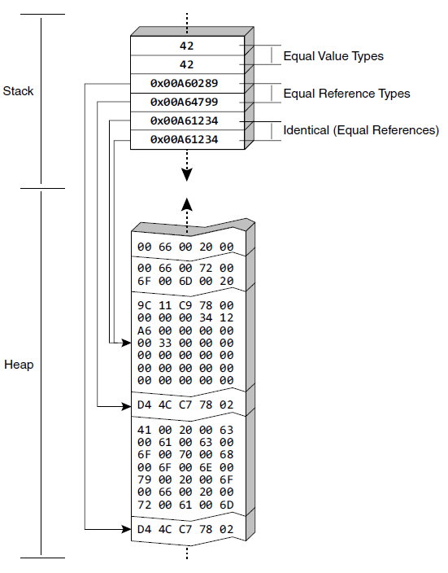
Identity

Slide 19
Contact Class
namespace Mad401.Lecture5 {
class Contact {
public string FirstName { get; set; }
public string LastName { get; set; }
public override string ToString() {
return $"{FirstName} {LastName}";
}
public override bool Equals(object obj) {
Contact contact = obj as Contact;
if (contact != null) {
if (this.FirstName.Equals(contact.FirstName) &&
this.LastName.Equals(contact.LastName)) return true;
}
return false;
}
}
}

Slide 20

Example
using System;
namespace Mad401.Lecture5 {
class Program {
static void Main(string[] args) {
Contact contact1 = new Contact();
Contact contact2 = new Contact();
contact1.FirstName = contact2.FirstName = "Nick";
contact1.LastName = contact2.LastName = "Sylvestre";
if (contact2 == contact2) {
Console.WriteLine("Objects are (identical) equal references");
}
if (Contact.ReferenceEquals(contact2, contact2)) {
Console.WriteLine("Objects are (identical) equal references");
}
if (contact1.Equals(contact2)) {
Console.WriteLine("Objects contain the same member values");
}
}
}
}

Slide 21
Operator Overloading
C# allows most operators to be overloaded
All operators are supported except x.y, f(x), new, typeof, default, checked, unchecked, delegate, is, as, =, and =>
Once Equals() is overridden, there is a possible inconsistency. That is, two objects could return true for Equals() but false for the == operator because == performs a reference equality check by default.
To correct this flaw, it is important to overload the equals (==) and not equals (!=) operators as well

Slide 22
Overloading == and !=
namespace Mad401.Lecture5 {
class Contact {
public string FirstName { get; set; }
public string LastName { get; set; }
public override string ToString() {
return $"{FirstName} {LastName}";
}
public override bool Equals(object obj) {
Contact contact = obj as Contact;
if ( contact != null ) {
if(this.FirstName.Equals(contact.FirstName) && this.LastName.Equals(contact.LastName)) return true;
}
return false;
}
public static bool operator ==(Contact lhs, Contact rhs) {
if(ReferenceEquals(lhs, null)){ // Prevents a recursive call (Stack Overflow)
return ReferenceEquals(rhs, null);
}
return lhs.Equals(rhs);
}
public static bool operator !=(Contact lhs, Contact rhs) {
return !(lhs == rhs);
}
}
}

Slide 23
Overloading Binary Operators
The +, -, *, /, %, &, |, ^, <<, and >> operators are implemented as binary static methods where at least one parameter is of the containing type
The method name is the operator prefixed by the word operator as a keyword.

Slide 24
Binary Operator Overload
namespace Mad401.Lecture5 {
class Coordinate {
public int x { get; set; }
public int y { get; set; }
public int z { get; set; }
public static Coordinate operator +(Coordinate c1, Coordinate c2) {
Coordinate c = new Coordinate();
c.x = c1.x + c2.x;
c.y = c1.y + c2.y;
c.z = c1.z + c2.z;
return c;
}
public override string ToString() {
return $"{x} {y} {z}";
}
}
}

Slide 25

Binary Operator Overload
using System;
namespace Mad401.Lecture5 {
class Program {
static void Main(string[] args) {
Coordinate c1 = new Coordinate();
c1.x = c1.y = c1.z = 1;
Coordinate c2 = new Coordinate();
c2.x = c2.y = c2.z = 2;
Coordinate c3 = c1 + c2;
Console.WriteLine(c3);
}
}
}

Slide 26
Assignment Binary Operators
As previously mentioned, there is no support for overloading the assignment operator.
However, assignment operators in combination with binary operators (+=, -=, *=, /=, %=, &=, |=, ^=, <<=, and >>=) are effectively overloaded when overloading the binary operator.

Slide 27
Conditional Logical Operator Overload
Like assignment operators, conditional logical operators cannot be overloaded explicitly.
However, because the logical operators & and | can be overloaded, and the conditional operators comprise the logical operators, effectively it is possible to overload conditional operators.
x && y is processed as x & y, where y must evaluate to true. Similarly, x || y is processed as x | y only if x is false
To enable support for evaluating a type to true or false—in an if statement, for example—it is necessary to override the true/false unary operators.

Slide 28
Unary Operator Overloading
Overloading unary operators is very similar to overloading binary operators, except that they take only one parameter, also of the containing type
Overloading true and false is subject to the additional requirement that both must be overloaded—not just one of the two
You can use types with overloaded true and false operators in if, do, while, and for controlling expressions.

Slide 29
Namespaces
Classes which do not define a namespace exist in the default global namespace
It is likely that such classes will experience a name collision, which occurs when you attempt to define two classes with the same name.
The resolution to this problem is to organize all the types, grouping them into logical related categories called namespaces.
Classes outside the System namespace are generally placed into a namespace corresponding with the company, product name, or both.
Namespaces should be PascalCase

Slide 30
Namespaces
Like classes, namespaces support nesting.
There are two ways to nest namespaces:
Nest them within one another (similar to classes)
Use the full namespace in a single namespace declaration in which a period separates each identifier

Slide 31
Garbage Collection
Garbage collection is a core function of the runtime. Its purpose is to restore memory consumed by objects that are no longer referenced.
The emphasis in this statement is on memory and references: The garbage collector is only responsible for restoring memory; it does not handle other resources such as database connections, handles (files, windows, and so on), network ports, and hardware devices such as serial ports.
The garbage collector determines what to clean up based on whether any references remain. This means that the garbage collector works with reference objects and restores memory on the heap only. Additionally, it means that maintaining a reference to an object will delay the garbage collector from reusing the memory consumed by the object.

Slide 32
Finalizers
Finalizers allow developers to write code that will clean up a class’s resources.
Unlike constructors that are called explicitly using the new operator, finalizers cannot be called explicitly from within the code.
The garbage collector is responsible for calling a finalizer on an object instance
namespace Mad401.Lecture5 {
class Database {
public Database() { // Constructor
//Create Database Connection
}
~Database() { // Finalizer
//Close Database Connection
}
}
}

Slide 33
Finalizers
Finalizers execute on their own thread, making their execution even less deterministic.
This indeterminate nature makes an unhandled exception within a finalizer (outside of the debugger) difficult to diagnose because the circumstances that led to the exception are not clear
You should take care to avoid exceptions within finalizers

Slide 34
Generics
To facilitate code reuse, especially the reuse of algorithms, C# includes a feature called generics
Generics provide a facility for creating data structures that can be specialized to handle specific types. Programmers define these parameterized types so that each variable of a particular generic type has the same internal algorithm, but the types of data and method signatures can vary based on the type arguments provided for the type parameters.

Slide 35
Benefits of Generics
Generics facilitate increased type safety, preventing data types other than those explicitly intended by the members within the parameterized class
Compile-time type checking reduces the likelihood of InvalidCastException type errors at runtime
Using value types with generic class members no longer causes a boxing conversion to object
Generics in C# reduce code bloat

Slide 36
Benefits of Generics
Performance improves because casting from an object is no longer required, thereby eliminating a type check operation
Generics reduce memory consumption by avoiding boxing and, therefore, consuming less memory on the heap
Code becomes more readable because of fewer casting checks and because of the need for fewer type-specific implementations
Editors that assist coding via some type of IntelliSense work directly with return parameters from generic classes

Slide 37
Generic Types
Generics are lexically similar to generic types in Java and templates in C++.
C# generics are very different from both Java generics and C++ templates in the details of their implementation and impact upon the type system of their respective languages.
In C#, the syntax for generic classes and structures uses angle brackets to both declare the generic type parameters in the type declaration and specify the generic type arguments when the type is used.

Slide 38
Declaring a Generic Class
You specify a type parameter (in this case, T) within angle brackets after the class name.
The type parameter T is a placeholder that must be supplied with a type argument.
The stack can store items of any stated type, without duplicating code or converting the item to type object.
namespace Mad401.Lecture5 {
class Stack<T> {
private T[] Elements { get; }
public void push(T obj) {
...
}
public T pop() {
...
}
}
}

Slide 39
Using a Generic Class
The generic Stack<T> can then be supplied with a single type argument that is “substituted” everywhere T appears in the class.
using System;
namespace Mad401.Lecture5 {
class Program {
static void Main(string[] args) {
Stack<int> stack;
stack = new Stack<int>();
}
}
}

Slide 40
Generic Interfaces
C# supports the use of generics throughout the language, including interfaces.
The syntax is identical to that used by classes. To declare an interface with a type parameter, place the type parameter in angle brackets immediately after the interface name
namespace Mad401.Lecture5 {
class Stack<T> : Interface1<T> {
public T item1 { get; set; }
public T item2 { get; set; }
private T[] Elements { get; }
public void push(T obj) {
...
}
public T pop() {
...
}
}
}
namespace Mad401.Lecture5 {
interface Interface1<T> {
T item1 { get; set; }
T item2 { get; set; }
}
}

Slide 41
Generic Interfaces
Support for generic interfaces is especially important for collection classes, where generics are most prevalent
Note that it is legal, and indeed common, for the type argument for one generic type to be a type parameter of another.

Slide 42
Generics
The constructors (and finalizer) of a generic class do not require type parameters
Generic types may declare any number of type parameters
namespace Mad401.Lecture5 {
class Stack<T> : Interface1<T> {
public Stack(T item) {
...
}
}
}
namespace Mad401.Lecture5 {
interface Interface1<TFirst, TSecond> {
TFirst item1 {get; set; }
TSecond item2 { get; set; }
}
}

Slide 43
Generic Methods
Generic methods use generic type parameters, much as generic types do
To declare a generic method, you specify the generic type parameters the same way you do for generic types: Add the type parameter declaration syntax immediately following the method name
namespace Mad401.Lecture5 {
class Stack<T> : Interface1<T> {
public T item1 { get; set; }
public T item2 { get; set; }
public T Compare() {
return (item1.Equals(item2) ) ? item1 : item2 ;
}
}
}

Slide 44
The end of Lecture 05

